Slide 1
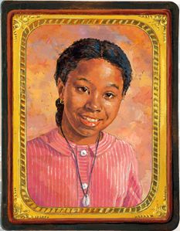
Aduke “Addy” Walker
Notes:
http://www.pptbackgroundstemplates.com/border-and-frame/120-paper-vintage-ribbons-backgrounds.html

Slide 2
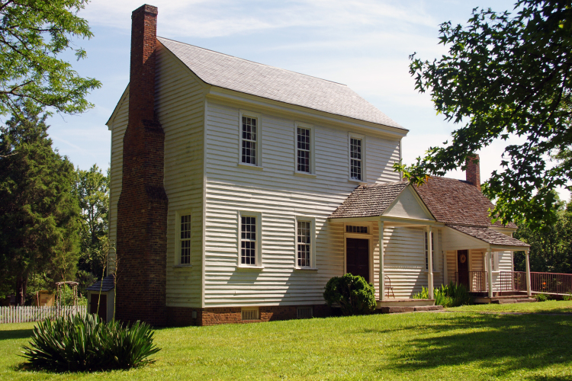
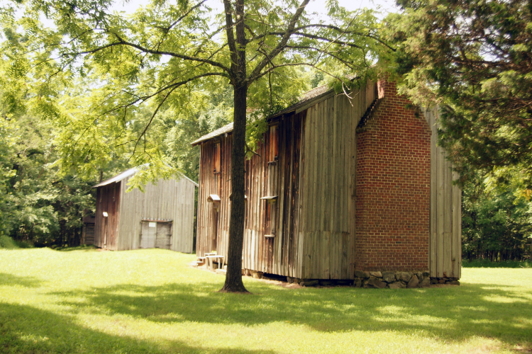
Stagville
Plantation
Notes:
Born Spring 1855
Picked April 25, 1855 as her birthday
Two Siblings
http://www.civilwardurham.com/antebellum.html

Slide 3
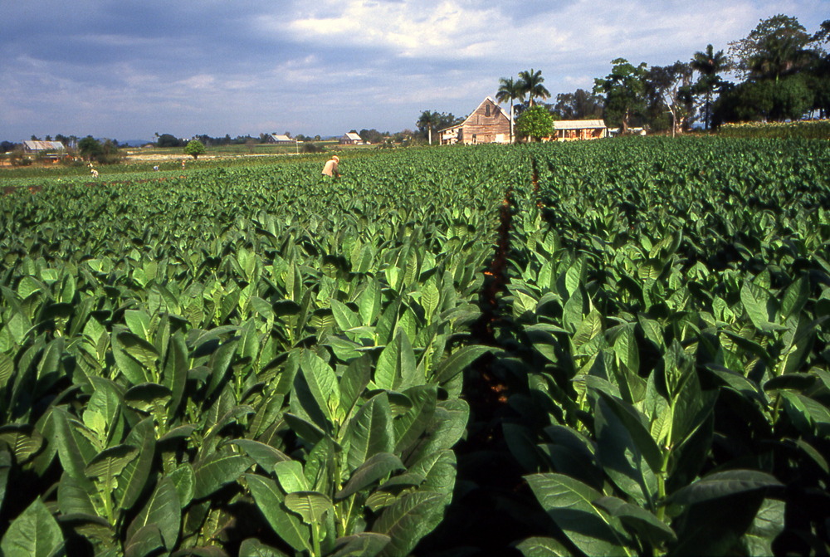
Tobacco Field
Notes:
Worming the Tobacco Field
Pulling Green Worms off the Plants

Slide 4
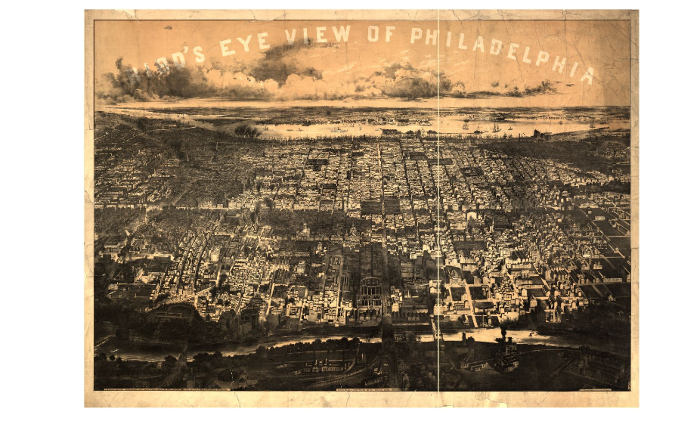
Philadelphia,
Pennsylvania

Slide 5
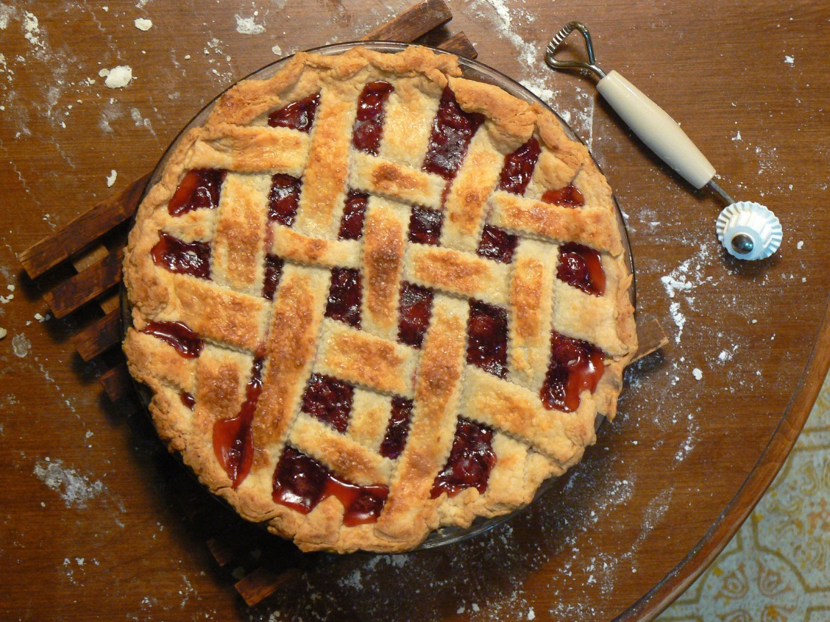
Cherry Pie

Slide 6
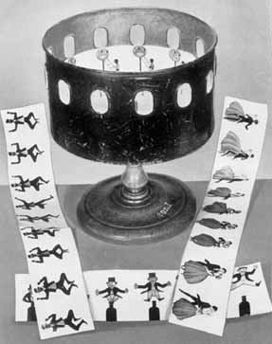
Fun and Games
https://www.youtube.com/watch?v=-hE_fA9M580
https://www.youtube.com/watch?v=fG6ywByMAyE

Slide 7

Thaumatropes
https://www.youtube.com/watch?v=A_2TW5X4H6E

Slide 8
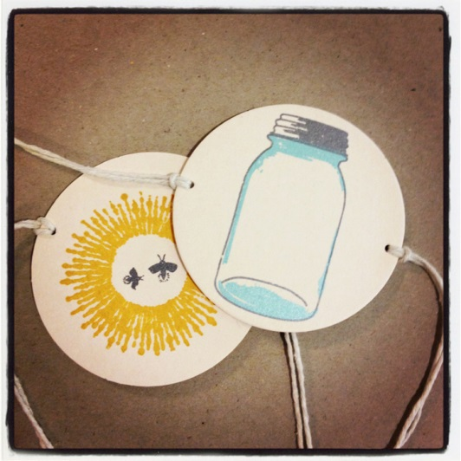

Examples

